Slide 1

TIC TAC TOE
Minimax Algorithm with Alpha-Beta Pruning
Artificial Intelligence & Expert Systems Lab | CSE404
University of Asia Pacific
Lamia Tabassum Orpa | Student ID: 22101184
Submitted to: Nahida Marzan, Lecturer, Dept. of CSE

Slide 2
Problem Statement
Tic Tac Toe is a two-player, zero-sum game where an AI must search a game tree to always make the optimal decision — a classic adversarial search problem.
❓
Game Complexity
🎯
Optimal Strategy
With up to 9! = 362,880 possible game states, naively checking every branch is wasteful and inefficient.
The AI must always make the best possible move — never lose a game it could have won or drawn, regardless of opponent play.
⚡
Search Efficiency
🎮
Dual Game Modes
Alpha-Beta Pruning cuts off branches guaranteed not to affect the result, making the search faster without changing the outcome.
The system must support both Human vs Computer and Computer vs Computer modes with independently adjustable AI difficulty.

Slide 3
Objectives
01
Implement a console-based Tic Tac Toe game on a 3×3 board with two-player logic and clean board display after every move.
02
Build an AI opponent using the Minimax algorithm that always selects the optimal move for any given board state.
03
Apply Alpha-Beta Pruning on top of Minimax to reduce nodes evaluated, without changing the final move selected.
04
Support Human vs Computer and Computer vs Computer modes, each with an independently adjustable AI search depth (1–9).
05
Clearly report the game result — a win for X, a win for O, or a draw — after every game concludes.

Slide 4





Tools & Technologies
Python 3.13
Primary programming language. No third-party packages required — only Python's built-in math module for ±infinity bounds in alpha-beta.
Visual Studio Code
Development environment with integrated terminal for running and testing the program interactively on Windows 11.
GitHub
Version control — source code and report available at https://github.com/lamiatabassumorpa/AI-lab
Minimax Algorithm
Core adversarial search that guarantees optimal play by exploring the full game tree from any board position.
Alpha-Beta Pruning
Optimization applied on top of Minimax — cuts branches that cannot affect the result, reducing nodes evaluated significantly.

Slide 5
Algorithm Design — Minimax
How Minimax Works
Pseudocode
Models the game as alternating MAX (AI) and MIN (opponent) turns.
function MINIMAX(board, depth,
alpha, beta, maximizing, player):
score = EVALUATE(board, player)
if score ≠ 0 or board full:
return score
if maximizing:
best = -∞
for each empty cell c:
place mark at c
val = MINIMAX(…, False, player)
undo move
best = max(best, val)
alpha = max(alpha, best)
if beta ≤ alpha: break ← β cut
return best
else: [mirror for minimizing]
On MAX turns — the AI picks the move with the highest score.
On MIN turns — the opponent picks the move with the lowest score.
Recurses until the game ends (win/draw) or the depth limit is hit.
Scores: +10 = AI wins, -10 = opponent wins, 0 = draw.
At depth 9, it explores the entire remaining game — guaranteed optimal play.

Slide 6
Alpha-Beta Pruning
Alpha-beta pruning adds two running bounds — α (best MAX can guarantee) and β (best MIN can guarantee) — and skips branches that cannot change the final result.
MAX
4
max(3,2,4) = 4 → AI picks branch B3
min(3,5)=3
min(4,8)=4
MIN
3
MIN
2
MIN
4
2 ≤ α(=3) → cut!
3
5
2
?
4
8
MAX node (AI)
MIN node (opponent)
Pruned – not evaluated

Slide 7
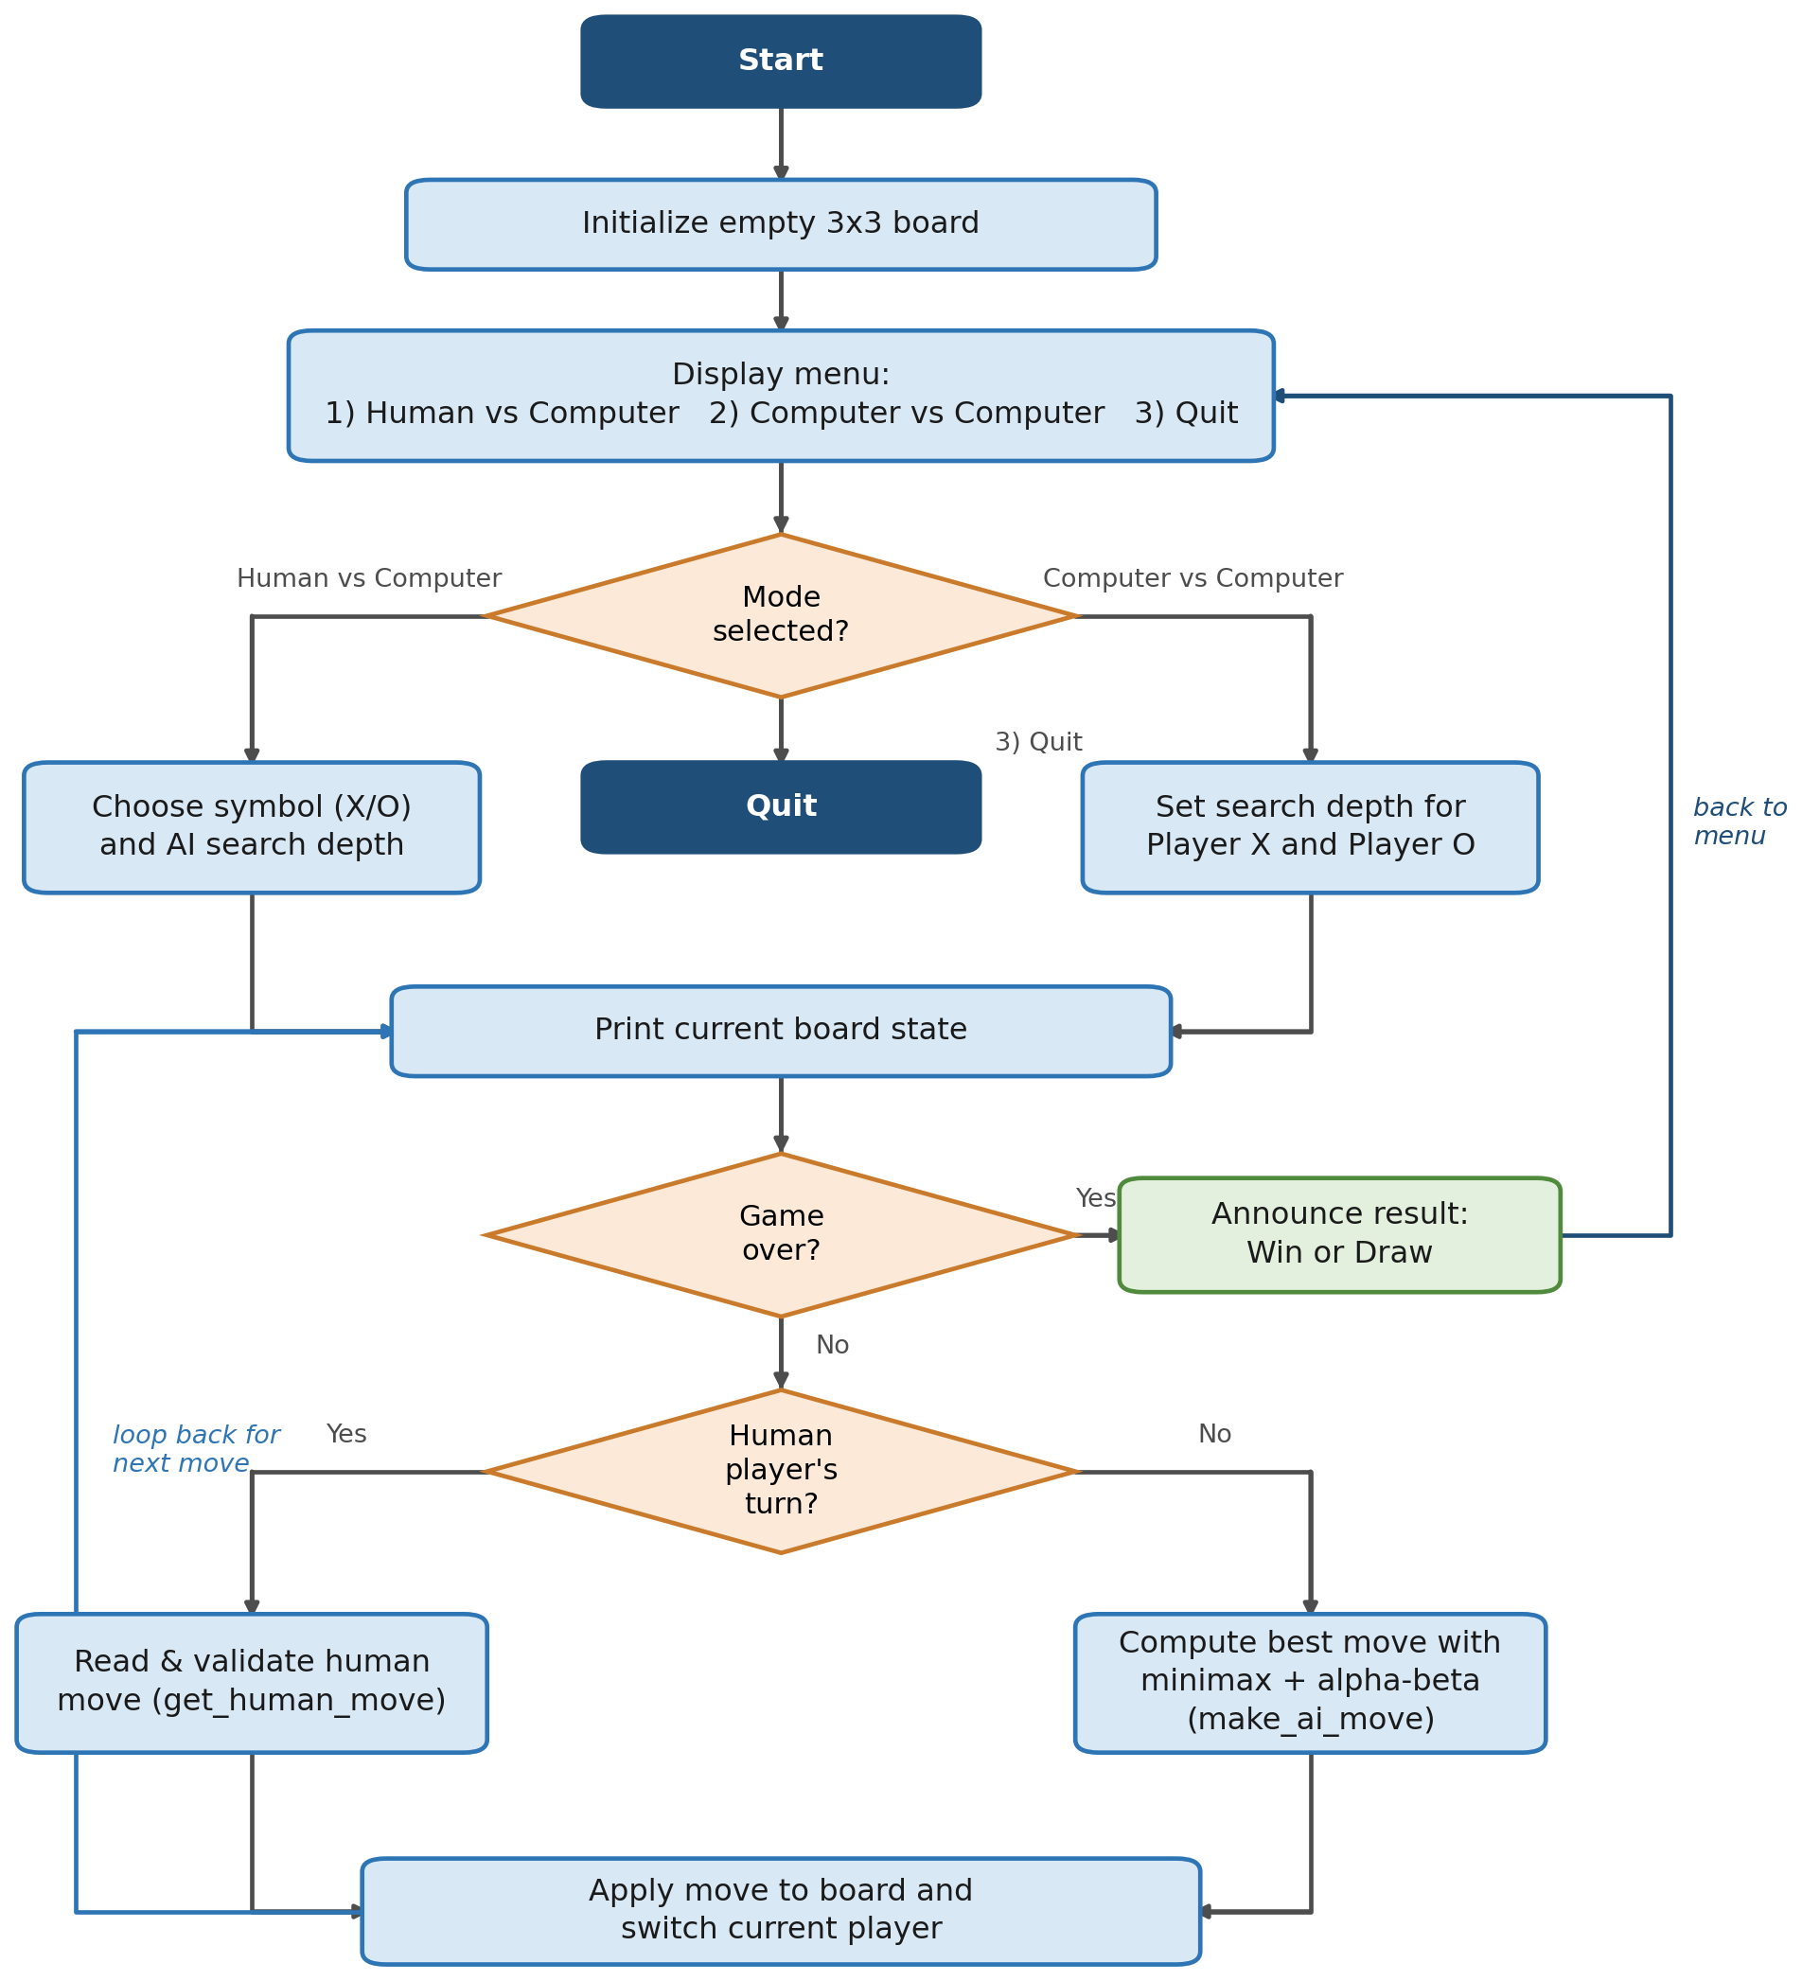
System Design
The program uses a 9-cell flat list for the board. Both game modes share one main loop — print → check game over → get move (human input or minimax) → apply → repeat.
Board Repr.
Flat list of 9 cells (indices 0–8). No 2D array needed.
Win Detection
8 fixed index combinations checked after every move.
Shared Logic
Both modes reuse the same minimax() and make_ai_move() functions.
Input Validation
get_human_move() loops until a valid, unoccupied cell is entered.
Depth Control
ask_depth() lets each player independently set difficulty 1–9.

Slide 8
Implementation Details
The program is built from 15 small, single-purpose functions — making the recursive minimax logic easy to test in isolation.
print_board(board)
make_ai_move(…)
Prints the 3×3 grid after every move
Calls minimax for each empty cell, plays the best one
get_winner(board)
get_human_move(board)
Checks all 8 win combos; returns 'X', 'O', or None
Reads + validates console input until a legal move is given
is_full(board)
play_human_vs_computer()
True if no empty cells remain (draw condition)
Runs a full HvC game: symbol choice, depth, main loop
evaluate_board(…)
play_computer_vs_computer()
Returns +10 / -10 / 0 from the AI's perspective
Runs a full CvC game with independent depths for X and O
minimax(…)
play_game()
Core recursive search with alpha-beta pruning
Displays the menu and dispatches to the chosen mode

Slide 9
Challenges Faced
01
Maximizing vs Minimizing Recursion
02
Evaluation Function Perspective
Keeping track of which side was scoring at each recursive level — the function alternates roles and it was easy to lose perspective several levels deep.
evaluate_board must always score from the original AI's perspective, not from the side currently moving. Mixing this up caused the AI to play self-defeating moves.
03
Alpha-Beta Cut-off Condition
04
Validating Console Input
05
Confirming Correctness
The pruning condition (β ≤ α) had to be exactly right — a wrong comparison didn't break the game visibly but either failed to prune or pruned incorrectly.
Human input needed to reject non-numeric text, out-of-range numbers, and already-occupied cells without crashing.
Minimax doesn't look obviously wrong even when subtly buggy. The most convincing test: Computer vs Computer at depth 9 must always draw.

Slide 10

Conclusion
Successfully implemented a console-based Tic Tac Toe game with an optimal AI using Minimax and Alpha-Beta Pruning in Python 3.
At search depth 9, the AI achieves perfect play — it never loses, and Computer vs Computer always ends in a draw, confirming correctness.
Alpha-Beta Pruning demonstrated meaningful efficiency gains: branches provably unable to change the outcome are skipped without affecting the move selected.
Adjustable search depth (1–9) makes the AI a configurable opponent — unbeatable at depth 9, beatable at lower depths for accessible difficulty.
Structuring the program into 15 small, single-purpose functions made the recursive minimax logic independently testable and easy to verify.
Course: CSE404 — AI & Expert Systems Lab | University of Asia Pacific

Slide 11

Resources & Links
Lab Report (.docx)
TicTacToe_Report_22101184.docx — submitted separately
GitHub Repository
github.com/lamiatabassumorpa/AI-lab
Source Code
tic_tac_toe.py — console-based Python 3, no dependencies

